Slide 1
Hands on with GraphRAG

Slide 2

Hi, ich bin Martin👋
@martinohanlon
Technical Curriculum Developer at Neo4j

Slide 3
Graphs and GenAI

Slide 4
LLMs aren’t perfect!
Notes:
LLMs generate garbage
Prompt in > Response out (based on the training data)

Slide 5


Slide 6

Notes:
LLMs tend to make things up.

Slide 7


Slide 8

Knowledge
Context
Enrichment
Language
Reasoning
Creativity

Slide 9
+
Knowledge
Context
Enrichment
Language
Reasoning
Creativity
KGs
LLMs
BETTER TOGETHER

Slide 10
What are Graphs?

Slide 11
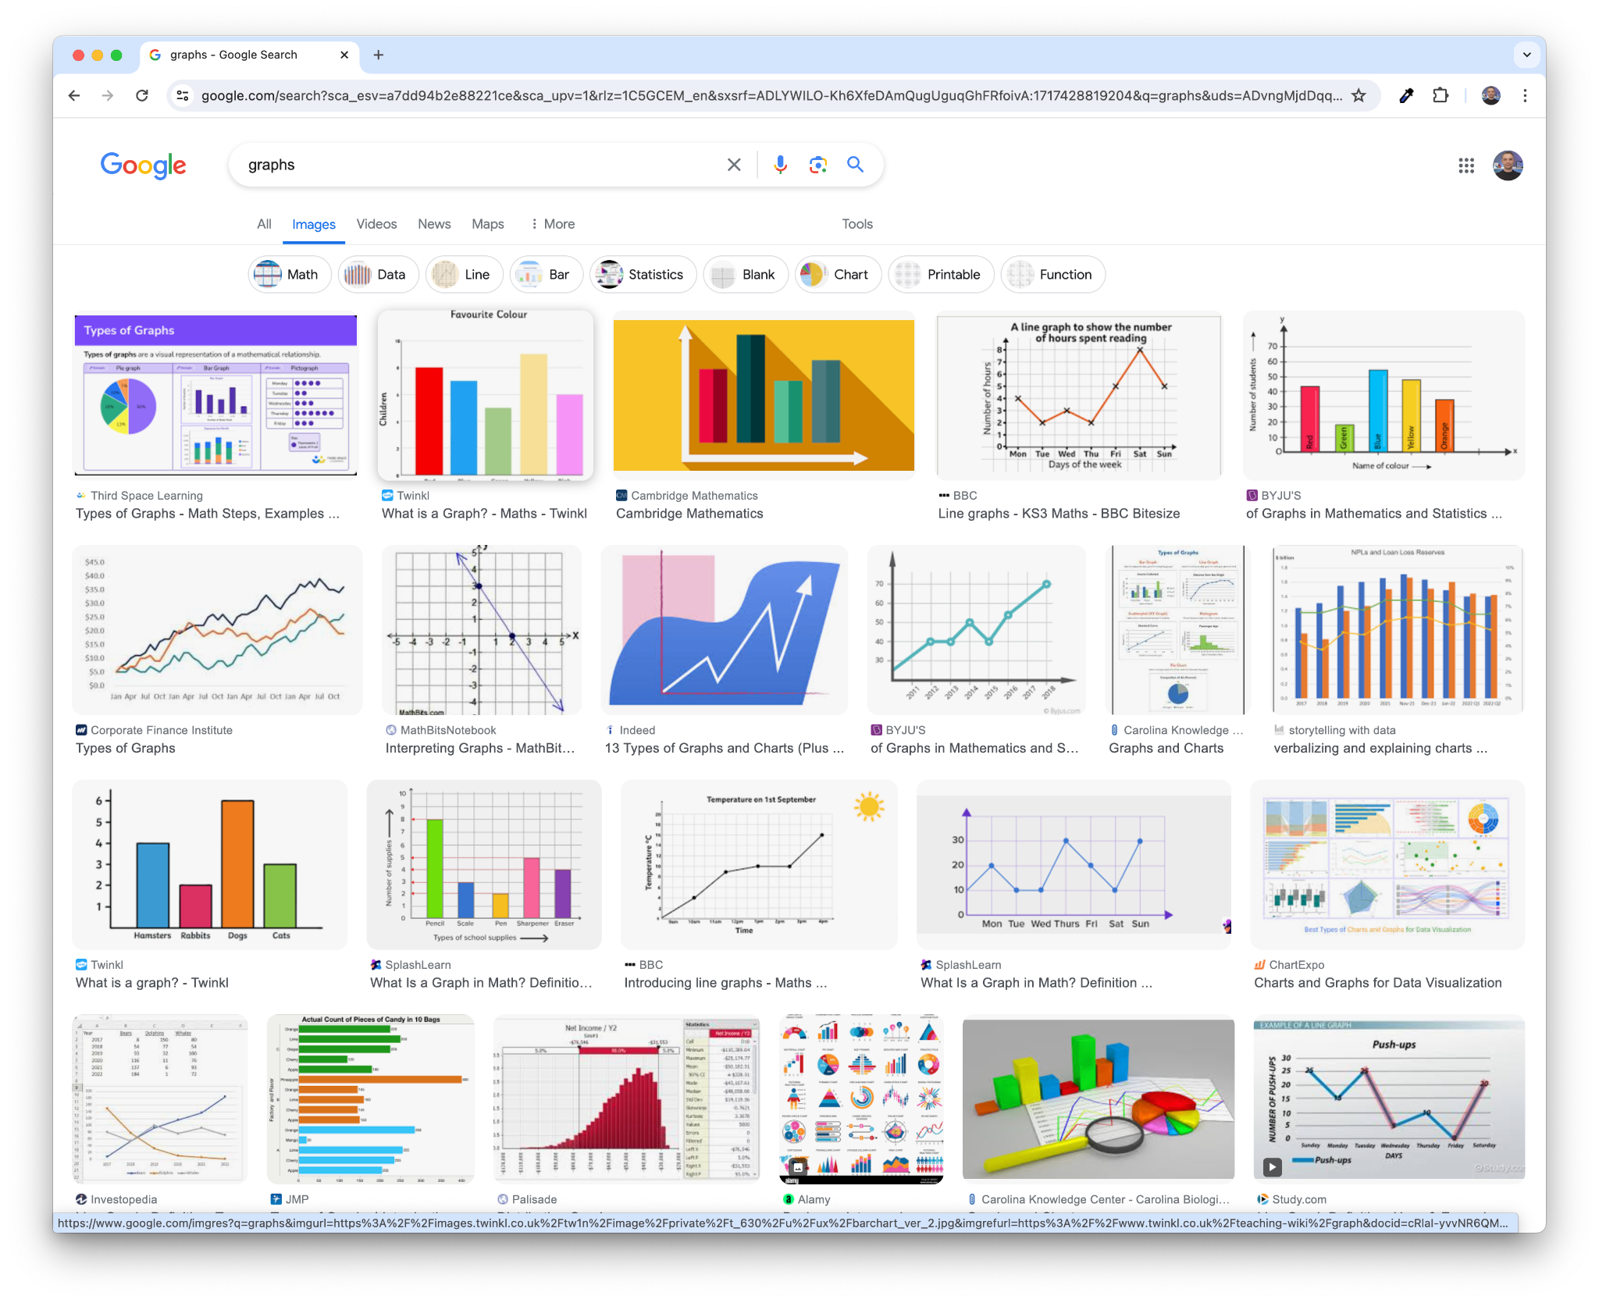
Notes:
When I say graphs, I dont mean these sorts of “charts”

Slide 12
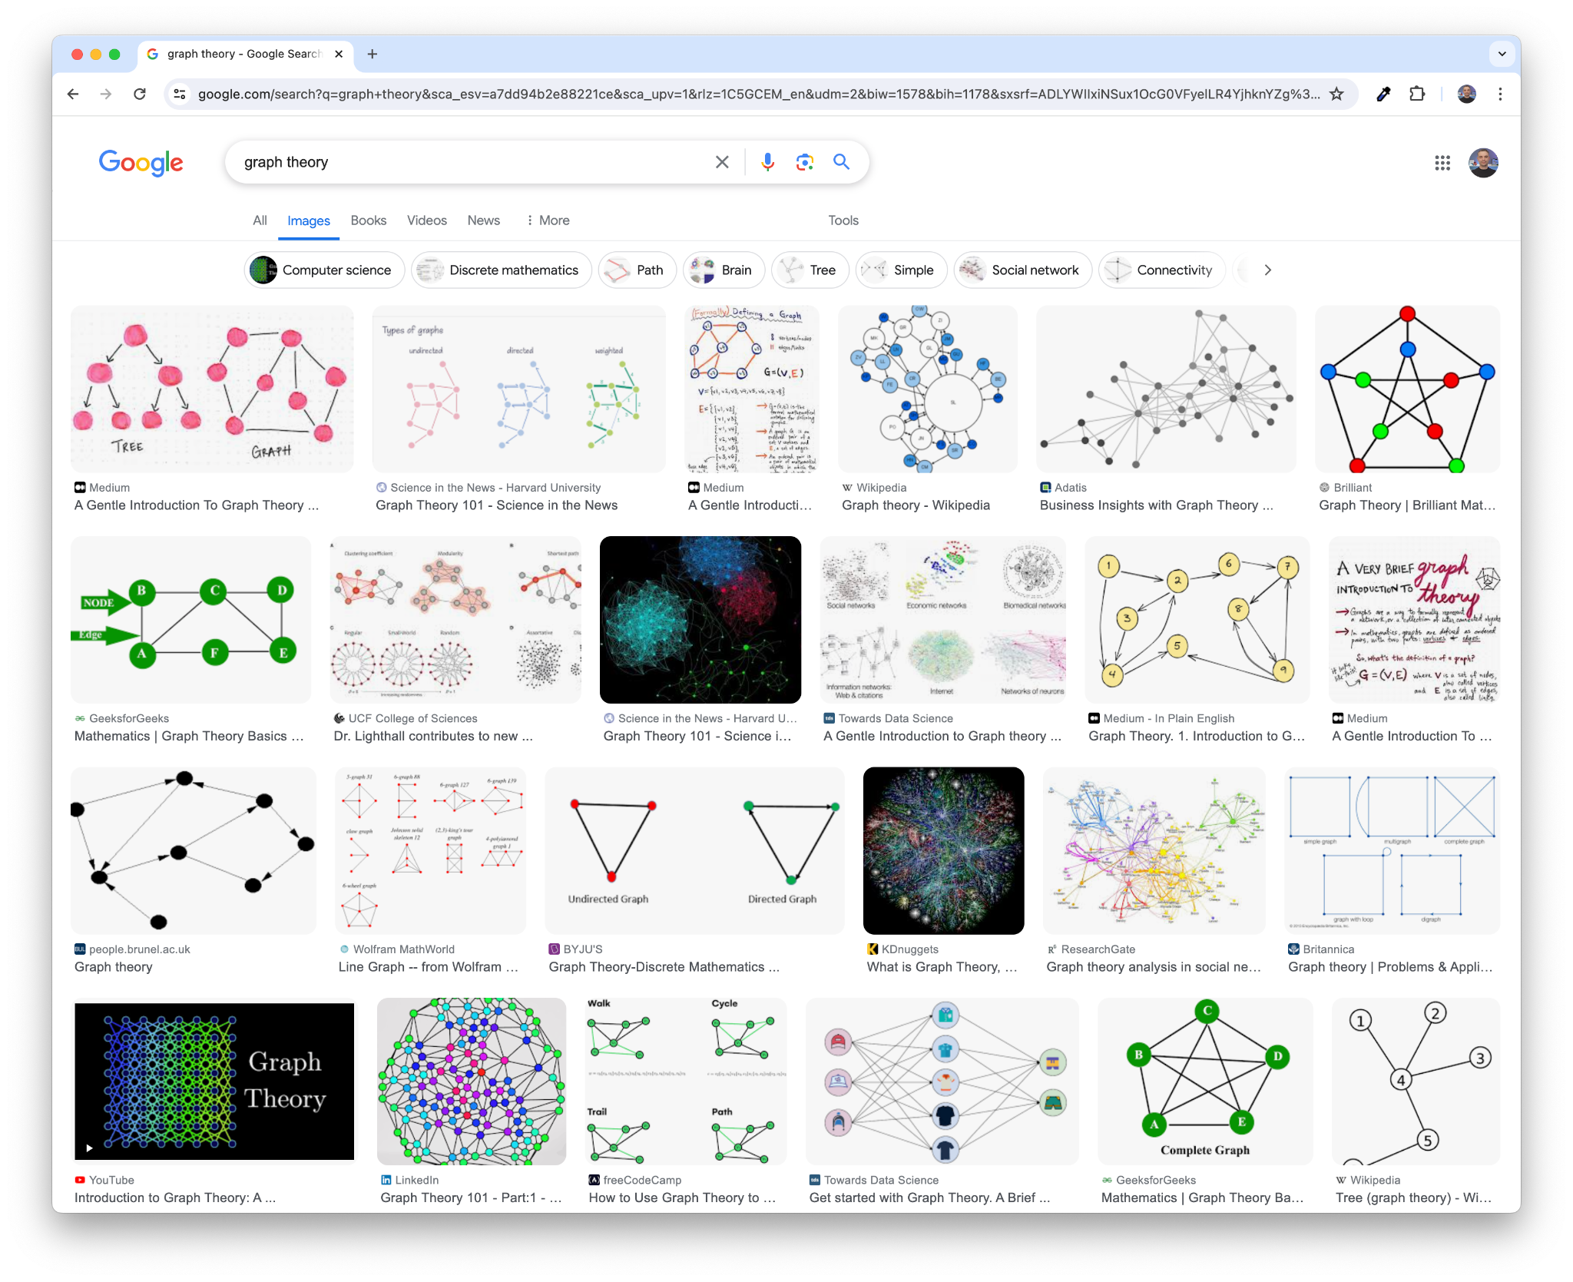
Notes:
I mean graphs like this edges and vertices - circles and line

Slide 13
Notes:
Graphs essentially consist of nodes, and these nodes represent things, they represent entities. In this case it's a MacBook, it could be a product, a car, a location, it's something physical.We can identify these nodes with one or more labels.

Slide 14
Toy Story
Notes:
Graphs essentially consist of nodes, and these nodes represent things, they represent entities. In this case it's a MacBook, it could be a product, a car, a location, it's something physical.We can identify these nodes with one or more labels.

Slide 15
Nodes represent things
Toy Story
Notes:
Graphs essentially consist of nodes, and these nodes represent things, they represent entities. In this case it's a MacBook, it could be a product, a car, a location, it's something physical.We can identify these nodes with one or more labels.

Slide 16
Nodes represent things
Toy Story
Movie
Notes:
Graphs essentially consist of nodes, and these nodes represent things, they represent entities. In this case it's a MacBook, it could be a product, a car, a location, it's something physical.We can identify these nodes with one or more labels.

Slide 17
Nodes can be identified by one or more labels
Nodes represent things
Toy Story
Movie
Notes:
Graphs essentially consist of nodes, and these nodes represent things, they represent entities. In this case it's a MacBook, it could be a product, a car, a location, it's something physical.We can identify these nodes with one or more labels.

Slide 18
Nodes can be identified by one or more labels
Nodes represent things
Toy Story
Movie
Animated
Notes:
Graphs essentially consist of nodes, and these nodes represent things, they represent entities. In this case it's a MacBook, it could be a product, a car, a location, it's something physical.We can identify these nodes with one or more labels.

Slide 19
Nodes can be identified by one or more labels
Nodes represent things
Toy Story
Movie
Animated
title: Toy Story
released: 1995
Notes:
Graphs essentially consist of nodes, and these nodes represent things, they represent entities. In this case it's a MacBook, it could be a product, a car, a location, it's something physical.We can identify these nodes with one or more labels.

Slide 20
Nodes can be identified by one or more labels
Nodes represent things
Toy Story
Movie
Animated
Nodes can hold properties as key/value pairs
title: Toy Story
released: 1995
Notes:
Graphs essentially consist of nodes, and these nodes represent things, they represent entities. In this case it's a MacBook, it could be a product, a car, a location, it's something physical.We can identify these nodes with one or more labels.

Slide 21
Toy Story
Movie
Notes:
Graphs essentially consist of nodes, and these nodes represent things, they represent entities. In this case it's a MacBook, it could be a product, a car, a location, it's something physical.We can identify these nodes with one or more labels.

Slide 22
Tom Hanks
Toy Story
Actor
Movie
Notes:
Graphs essentially consist of nodes, and these nodes represent things, they represent entities. In this case it's a MacBook, it could be a product, a car, a location, it's something physical.We can identify these nodes with one or more labels.

Slide 23
Tom Hanks
Toy Story
Actor
Movie
Notes:
Graphs essentially consist of nodes, and these nodes represent things, they represent entities. In this case it's a MacBook, it could be a product, a car, a location, it's something physical.We can identify these nodes with one or more labels.

Slide 24
Relationships connect two nodes
Tom Hanks
Toy Story
Actor
Movie
Notes:
Graphs essentially consist of nodes, and these nodes represent things, they represent entities. In this case it's a MacBook, it could be a product, a car, a location, it's something physical.We can identify these nodes with one or more labels.

Slide 25
Relationships connect two nodes
Tom Hanks
Toy Story
Actor
Movie
ACTED_IN
Notes:
Graphs essentially consist of nodes, and these nodes represent things, they represent entities. In this case it's a MacBook, it could be a product, a car, a location, it's something physical.We can identify these nodes with one or more labels.

Slide 26
Relationships connect two nodes
Tom Hanks
Relationships
have a type
Toy Story
Actor
Movie
ACTED_IN
Notes:
Graphs essentially consist of nodes, and these nodes represent things, they represent entities. In this case it's a MacBook, it could be a product, a car, a location, it's something physical.We can identify these nodes with one or more labels.

Slide 27
Relationships connect two nodes
Tom Hanks
Relationships
have a type
Toy Story
Actor
Movie
ACTED_IN
Relationships
have a direction
Notes:
Graphs essentially consist of nodes, and these nodes represent things, they represent entities. In this case it's a MacBook, it could be a product, a car, a location, it's something physical.We can identify these nodes with one or more labels.

Slide 28
Relationships connect two nodes
Tom Hanks
Relationships
have a type
Toy Story
Actor
Movie
ACTED_IN
roles: Woody
Relationships
have a direction
Notes:
Graphs essentially consist of nodes, and these nodes represent things, they represent entities. In this case it's a MacBook, it could be a product, a car, a location, it's something physical.We can identify these nodes with one or more labels.

Slide 29
Relationships connect two nodes
Tom Hanks
Relationships
have a type
Toy Story
Actor
Movie
ACTED_IN
roles: Woody
Relationships can also hold properties as key/value pairs
Relationships
have a direction
Notes:
Graphs essentially consist of nodes, and these nodes represent things, they represent entities. In this case it's a MacBook, it could be a product, a car, a location, it's something physical.We can identify these nodes with one or more labels.

Slide 30













Graphs are
everywhere
Customer
Recommendations Loyalty Programs Churn Prevention Customer Offers Dynamic Pricing Intelligent Ads
Product
Suppliers
Product Recommendations New Product Introductions Product Customizations Product Inventory Product Pricing
Route Planning & Optimization Real-time Shipment Tracking Inventory Planning Risk Analysis
Employee
Talent Learning & Development Career Management Skills Management Orgs (who is who) Job Search
Transactions
Anti-money Laundering Circular Payments Fraud Detection
Network & Security
Account/Identity Control Adaptive & Intelligent Reputation Scoring Threat Detection Access Control Zero Trust
Process
Bottleneck Identification Process Improvement Process Automation Process Monitoring
Notes:
https://docs.google.com/presentation/d/1DDOwJGbVvAJ7GPAKthP3sXhjni3XM2Ze9-HvvjWtdrg/edit#slide=id.g28773348aed_1_350
Once a company introduces these seven graphs, even more magic can happen by connecting the graphs - there is no need for data to be siloed into departments, only to be connected through forced joins. The power is in connecting the graphs - which stores relationships as first party. Now the business can truly transform at the speed of the business - without the required overhead of relational models, joins, fixed schemas - which can all truly slow the business of insights.

Slide 31
Graph databases are designed to efficiently store and query complex networks of nodes and relationships
Notes:
Graph databases are designed from the ground up to efficiently handle highly connected datasets - from the UNDERLYING data storage to the query language.

Slide 32
Retrieval augmented generation

Slide 33
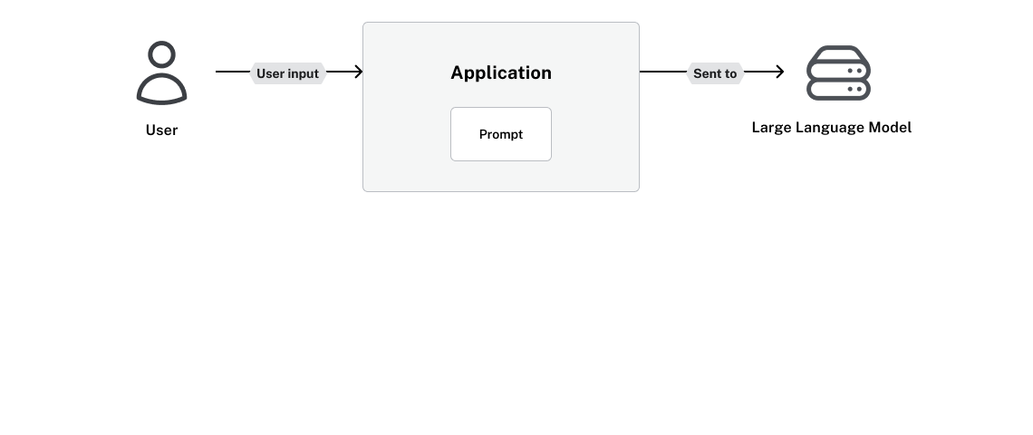
Interacting with LLMs

Slide 34
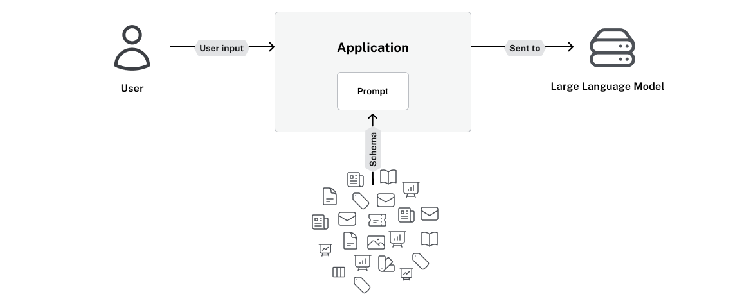
Interacting with LLMs
Context

Slide 35
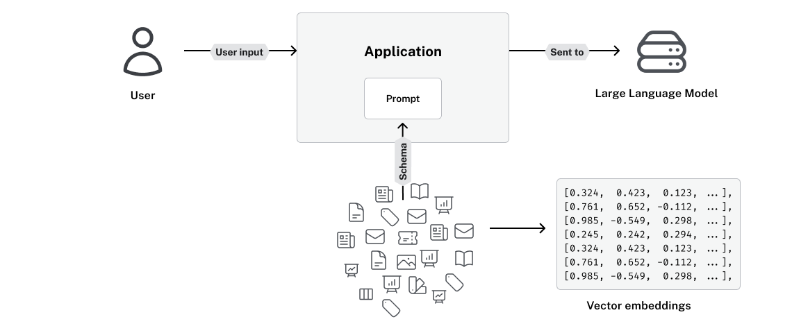
Interacting with LLMs
Context

Slide 36
Vector embeddings
Text | Vector embedding
She’s just a small town girl | [0.12, -0.34, 0.56, 0.78, ..., -0.91]
Living in a lonely world | [0.22, 0.45, -0.67, 0.11, ..., 0.33]
She took the midnight train | [-0.55, 0.89, 0.12, -0.44, ..., 0.67]
Going anywhere | [0.78, -0.23, 0.45, 0.91, ..., -0.12]

Slide 37
Where vector search fall short
Vectors work well for:
Contextual or Meaning Based Questions
Synonyms or Paraphrasing
Fuzzy or Vague queries
Broad or Open-Ended questions
Complex queries with multiple concepts
What does Paul Graham think about Generative AI?
Vectors are ineffective for:
Notes:
Types of Questions That Can Be Answered by Vector Semantic Search:
Contextual or Meaning-Based Queries:
Vector search excels at understanding the intent and context of a query, even if the exact terms are not matched.
Example: If you ask for "What are the health benefits of green tea?", it can retrieve documents that talk about antioxidants or cancer prevention even if the exact phrase "health benefits of green tea" isn’t used.
Synonym or Paraphrase Matching:
Because vector search captures the meaning behind words, it can handle queries with synonyms or paraphrased content.
Example: Searching for "happy" could also retrieve content about "joyful" or "cheerful."
Fuzzy or Vague Queries:
Queries that are not specific, such as "good restaurants nearby," can still yield relevant results as the search is based on the conceptual relationship between the words.
Example: It could retrieve results for "best restaurants" or "top-rated dining places" even though the exact phrase was not used.
Broad or Open-Ended Questions:
Vector search can provide relevant results even for questions without a clear-cut answer because it surfaces related concepts and documents.
Example: "What is the future of AI?" might return articles discussing various aspects of AI, such as its applications, risks, and potential developments.
Complex Queries with Multiple Concepts:
Vector search can handle queries that involve more than one idea or concept and match documents that discuss those ideas together, even if they are not explicitly connected.
Example: "Impact of climate change on agriculture and food security" can return results that discuss both concepts together.
Types of Questions That Cannot Be Effectively Answered by Vector Semantic Search:
Highly Specific or Fact-Based Queries:
Vector search is not designed for pinpointing exact facts or retrieving specific structured data like names, dates, or precise answers.
Example: "What is the capital of France?" would be better suited for a keyword search because the answer is very clear and specific (Paris).
Numerical or Exact-Match Queries:
Queries that require exact numerical values or specific measurements may not perform well because vector search focuses on meaning, not precision.
Example: "How many grams are in a kilogram?" would require a precise, structured answer.
Boolean or Logical Queries:
Vector search does not handle queries that require logical operators or boolean conditions very well.
Example: A query like "Show documents that contain 'A' but not 'B'" would be better handled by a traditional keyword-based search engine.
Ambiguous or Unclear Queries Without Enough Context:
If the query is very ambiguous or lacks enough context for the model to understand intent, vector search may return results that are too broad or unrelated.
Example: Searching for "cat" without context could return documents about pets, cat breeds, or even "CAT" as an acronym (e.g., Common Admission Test), depending on how the vector search system was trained.
Specialized Knowledge or Niche Domains:
If the vector search model isn’t trained on specific or highly specialized domains, it may not understand the nuances or produce relevant results.
Example: A query involving highly technical jargon, such as "methods of CRISPR gene editing," would depend on the dataset the model was trained on.
Summary:
Best suited for: Semantic, meaning-based, contextual, and vague questions, as well as queries involving synonyms or related concepts.
Not well-suited for: Exact, fact-based, numerical, or logical queries where precision is key.

Slide 38
Where vector search fall short
Vectors work well for:
Contextual or Meaning Based Questions
Synonyms or Paraphrasing
Fuzzy or Vague queries
Broad or Open-Ended questions
Complex queries with multiple concepts
What does Paul Graham think about Generative AI?
Vectors are ineffective for:
Highly Specific or Fact-Based Questions
Numerical or Exact-Match Queries
Boolean or Logical Queries
Ambiguous or Unclear Queries without Context
Specialised Knowledge
How many Generative AI Startups has Paul Graham invested in?
Notes:
Types of Questions That Can Be Answered by Vector Semantic Search:
Contextual or Meaning-Based Queries:
Vector search excels at understanding the intent and context of a query, even if the exact terms are not matched.
Example: If you ask for "What are the health benefits of green tea?", it can retrieve documents that talk about antioxidants or cancer prevention even if the exact phrase "health benefits of green tea" isn’t used.
Synonym or Paraphrase Matching:
Because vector search captures the meaning behind words, it can handle queries with synonyms or paraphrased content.
Example: Searching for "happy" could also retrieve content about "joyful" or "cheerful."
Fuzzy or Vague Queries:
Queries that are not specific, such as "good restaurants nearby," can still yield relevant results as the search is based on the conceptual relationship between the words.
Example: It could retrieve results for "best restaurants" or "top-rated dining places" even though the exact phrase was not used.
Broad or Open-Ended Questions:
Vector search can provide relevant results even for questions without a clear-cut answer because it surfaces related concepts and documents.
Example: "What is the future of AI?" might return articles discussing various aspects of AI, such as its applications, risks, and potential developments.
Complex Queries with Multiple Concepts:
Vector search can handle queries that involve more than one idea or concept and match documents that discuss those ideas together, even if they are not explicitly connected.
Example: "Impact of climate change on agriculture and food security" can return results that discuss both concepts together.
Types of Questions That Cannot Be Effectively Answered by Vector Semantic Search:
Highly Specific or Fact-Based Queries:
Vector search is not designed for pinpointing exact facts or retrieving specific structured data like names, dates, or precise answers.
Example: "What is the capital of France?" would be better suited for a keyword search because the answer is very clear and specific (Paris).
Numerical or Exact-Match Queries:
Queries that require exact numerical values or specific measurements may not perform well because vector search focuses on meaning, not precision.
Example: "How many grams are in a kilogram?" would require a precise, structured answer.
Boolean or Logical Queries:
Vector search does not handle queries that require logical operators or boolean conditions very well.
Example: A query like "Show documents that contain 'A' but not 'B'" would be better handled by a traditional keyword-based search engine.
Ambiguous or Unclear Queries Without Enough Context:
If the query is very ambiguous or lacks enough context for the model to understand intent, vector search may return results that are too broad or unrelated.
Example: Searching for "cat" without context could return documents about pets, cat breeds, or even "CAT" as an acronym (e.g., Common Admission Test), depending on how the vector search system was trained.
Specialized Knowledge or Niche Domains:
If the vector search model isn’t trained on specific or highly specialized domains, it may not understand the nuances or produce relevant results.
Example: A query involving highly technical jargon, such as "methods of CRISPR gene editing," would depend on the dataset the model was trained on.
Summary:
Best suited for: Semantic, meaning-based, contextual, and vague questions, as well as queries involving synonyms or related concepts.
Not well-suited for: Exact, fact-based, numerical, or logical queries where precision is key.

Slide 39
Interacting with LLMs
Context

Slide 40
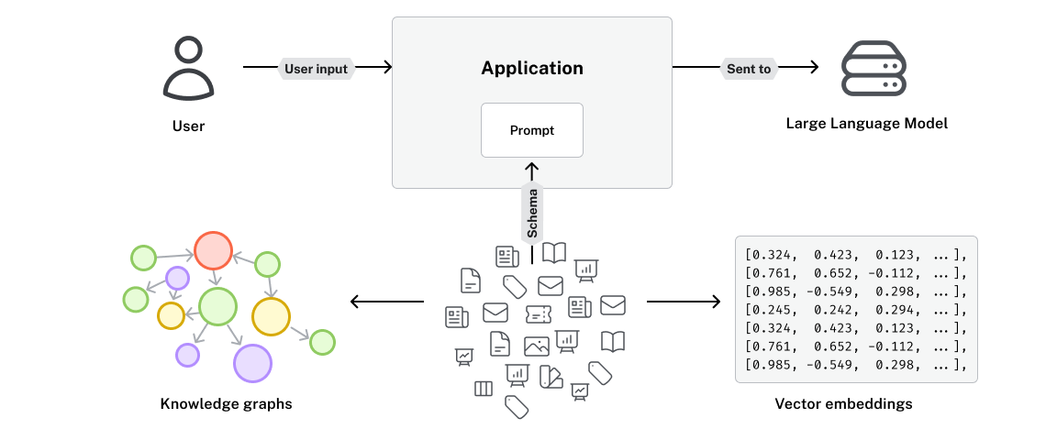
Interacting with LLMs
Context

Slide 41
Vector embeddings and a knowledge graph
Text | Vector embedding
She’s just a small town girl | [0.12, -0.34, 0.56, ...,-0.91]
Living in a lonely world | [0.22, 0.45, -0.67, ..., 0.33]
She took the midnight train | [-0.55, 0.89, 0.12, ..., 0.67]
Going anywhere | [0.78, -0.23, 0.45, ...,-0.12]

Slide 42
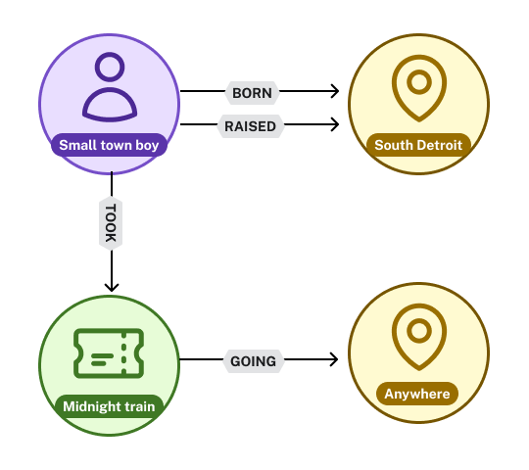
Vector embeddings and a knowledge graph
Text | Vector embedding
She’s just a small town girl | [0.12, -0.34, 0.56, ...,-0.91]
Living in a lonely world | [0.22, 0.45, -0.67, ..., 0.33]
She took the midnight train | [-0.55, 0.89, 0.12, ..., 0.67]
Going anywhere | [0.78, -0.23, 0.45, ...,-0.12]

Slide 43
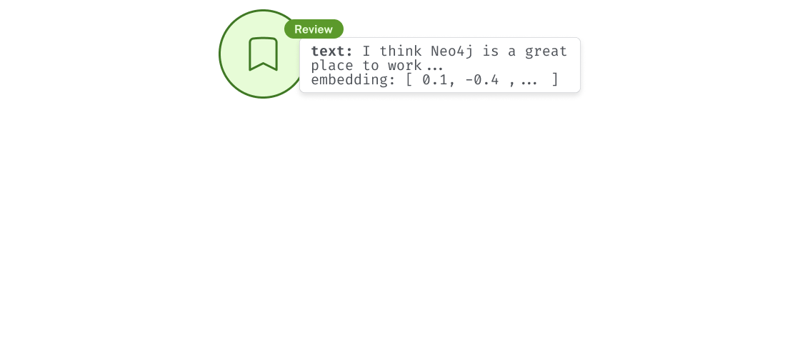
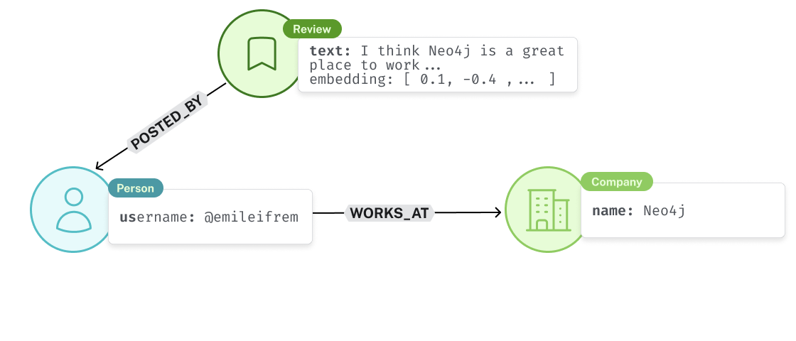
Context is key

Slide 44
Context is key
According to the provided context, Neo4j is a great place to work…

Slide 45
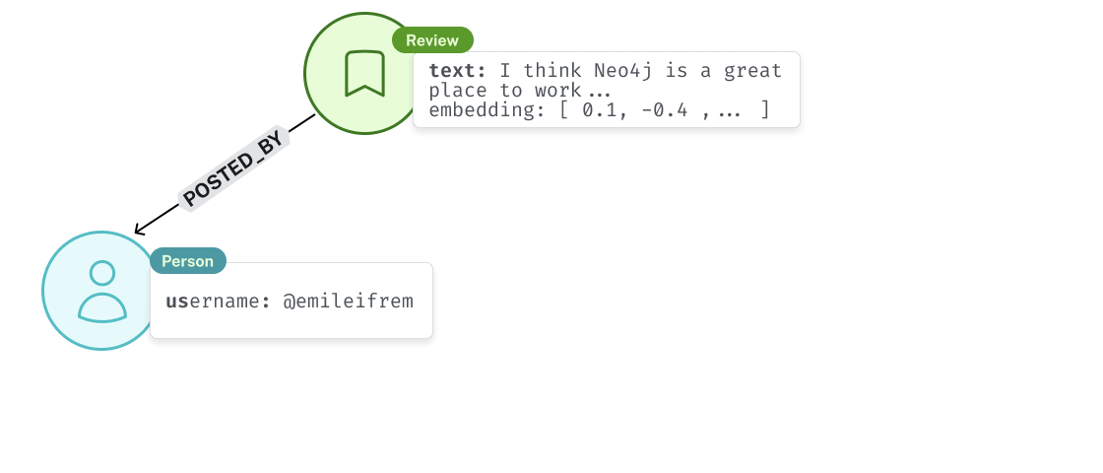
Context is key

Slide 46
Context is key

Slide 47
Context is key
According to Emil Eifrem, the CEO, Neo4j is a great place to work…

Slide 48
Knowledge Graphs
Building Graphs from unstructured data

Slide 49
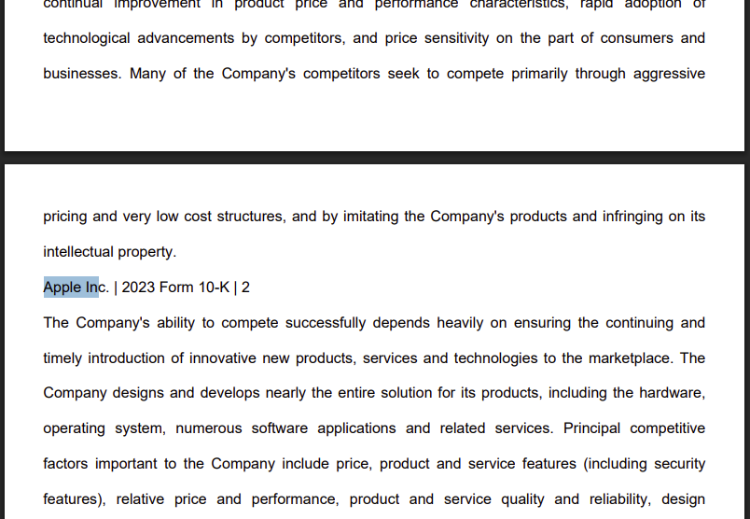

Slide 50
Asset
Manager
Product
Structured
FinancialMetric
Unstructured
Stock
Type
Chunk
Document
Company
Transaction
Time
Period
Risk
Factor
Executive

Slide 51
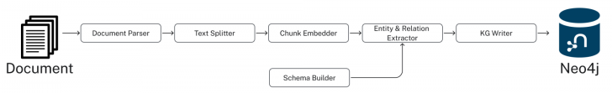
pipeline = SimpleKGPipeline(
driver=driver, # Neo4j connection driver
llm=llm, embedder=embedder, # OpenAI llm and embeddings
entities=entities, relations=relations, # Define schema
enforce_schema="STRICT",
prompt_template=prompt_template,
)
# Process the SEC filing documents
pdf_documents = [
"apple-10K-2023.pdf", "microsoft-10K-2023.pdf",
# ... more company filings
]
# Run the pipeline to transform PDFs into knowledge graph
for pdf_file in pdf_documents:
pipeline.run(file_path=pdf_file)

Slide 52
Schema driven extraction
Company
Executive
Product
FinancialMetric
RiskFactor
StockType
Transaction
TimePeriod
Company HAS_METRIC FinancialMetric
Company FACES_RISK RiskFactor
Company ISSUED_STOCK StockType
Company MENTIONS Product

Slide 53

DEMO
Notes:
MATCH (d:Document)<-[f:FROM_DOCUMENT]-(c:Chunk)
RETURN d,f,c
MATCH (c:Company)-[m:MENTIONS]->(p:Product)
RETURN c,m,p
// Count what entities were extracted by type
MATCH (e)
WHERE NOT e:Document AND NOT e:Chunk
RETURN labels(e) as entityType, count(e) as count
ORDER BY count DESC
// Find all financial metrics for a specific company
MATCH (c:Company {name: 'MICROSOFT CORP'})-[:HAS_METRIC]->(m:FinancialMetric)
RETURN c.name, m.name
LIMIT 10
// Discover risk factors across all companies
MATCH (c:Company)-[:FACES_RISK]->(r:RiskFactor)
RETURN c.name, r.name
LIMIT 50
// Use vector index to find chunks
WITH genai.vector.encode(
"What are the risks that Microsoft faces?",
"OpenAI",
{ token: $token }) AS userEmbedding
CALL db.index.vector.queryNodes('chunkEmbeddings', 6, userEmbedding)
YIELD node, score
RETURN node
// vector search + graph
WITH genai.vector.encode(
"What are the risks that Microsoft faces?",
"OpenAI",
{ token: $token }) AS userEmbedding
CALL db.index.vector.queryNodes('chunkEmbeddings', 6, userEmbedding)
YIELD node, score
MATCH (node)-[:FROM_DOCUMENT]->(doc:Document)-[:FILED]-(company:Company)-[fr:FACES_RISK]->(risk:RiskFactor)
RETURN company, fr, risk

Slide 54
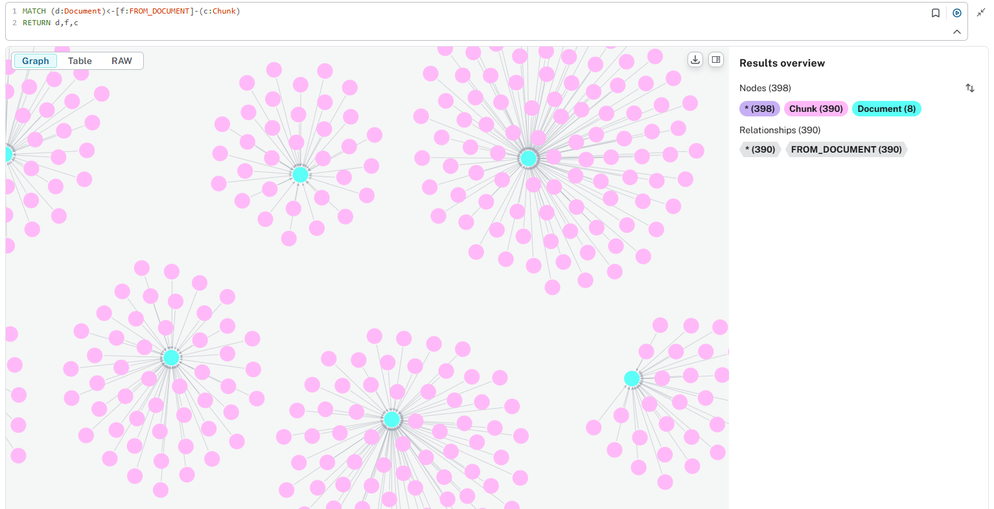
MATCH (d:Document)<-[f:FROM_DOCUMENT]-(c:Chunk)
RETURN d,f,c

Slide 55
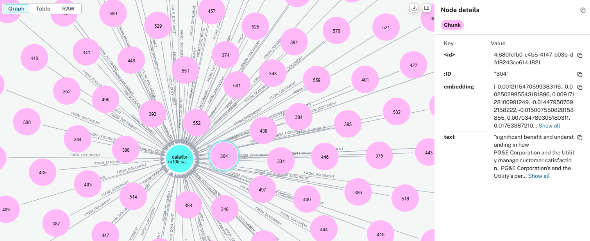
MATCH (d:Document)<-[f:FROM_DOCUMENT]-(c:Chunk)
RETURN d,f,c

Slide 56
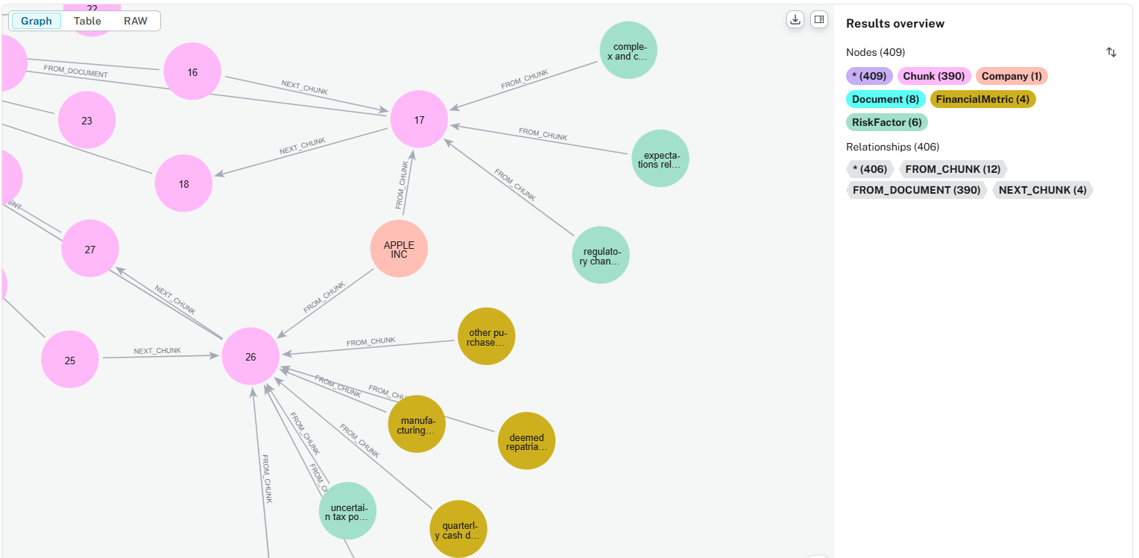
MATCH (d:Document)<-[f:FROM_DOCUMENT]-(c:Chunk)
RETURN d,f,c

Slide 57
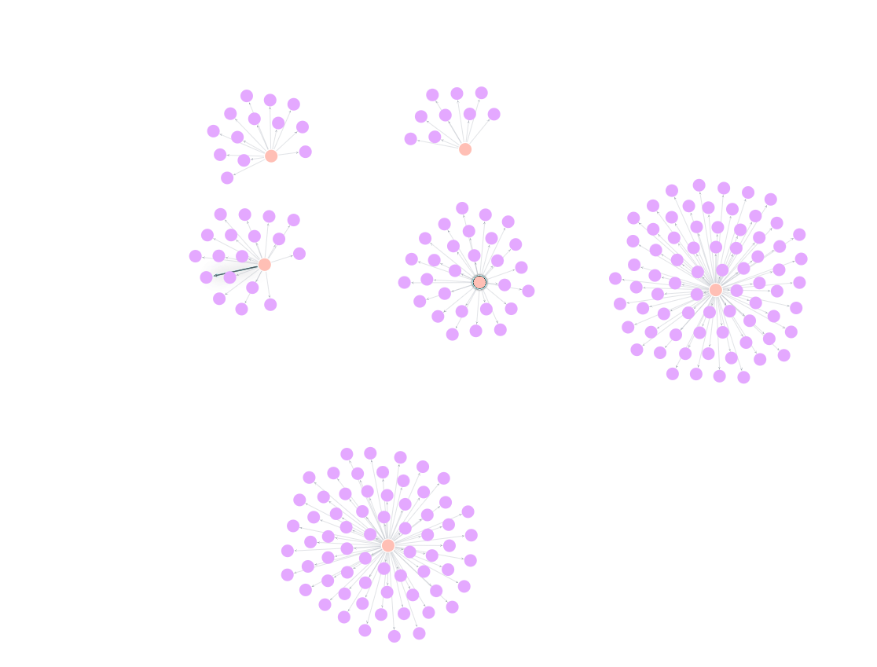
MATCH (c:Company)-[m:MENTIONS]->(p:Product)
RETURN c,m,p

Slide 58
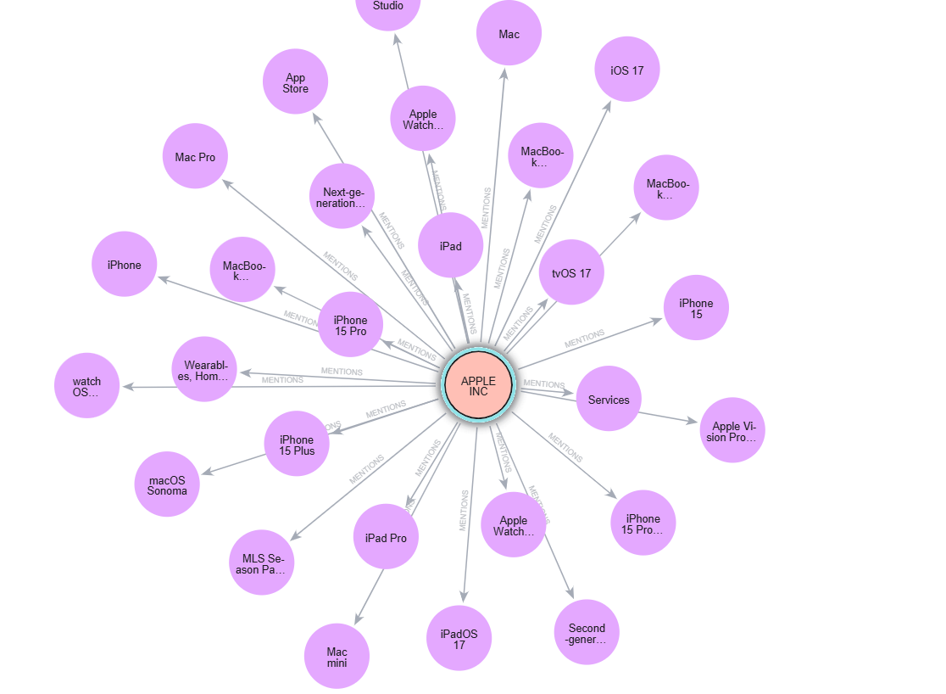
MATCH (c:Company)-[m:MENTIONS]->(p:Product)
RETURN c,m,p

Slide 59
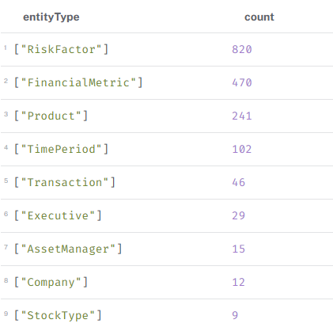
MATCH (e) WHERE NOT e:Document AND NOT e:Chunk
RETURN
labels(e) as entityType,
count(e) as count
ORDER BY count DESC

Slide 60
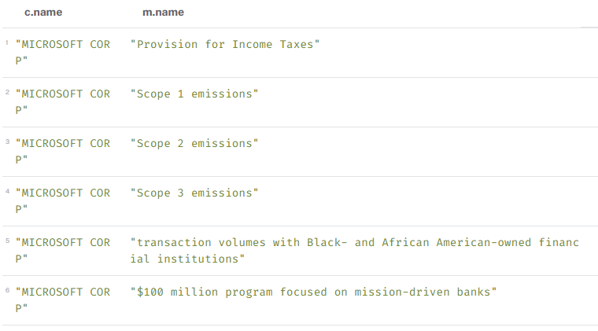
MATCH (c:Company {name: 'MICROSOFT CORP'})
-[:HAS_METRIC]->(m:FinancialMetric)
RETURN c.name, m.name

Slide 61
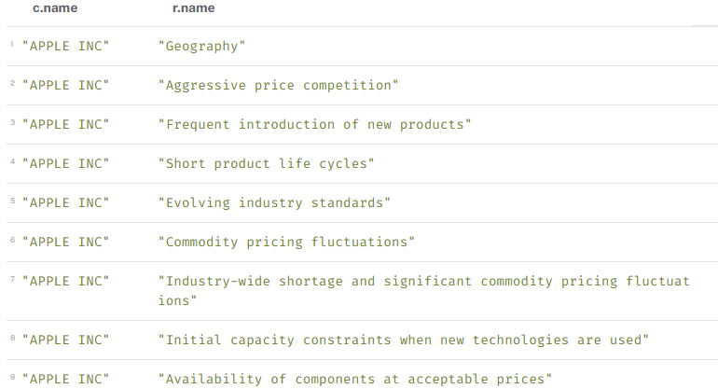
MATCH (c:Company)-[:FACES_RISK]->(r:RiskFactor)
RETURN c.name, r.name

Slide 62
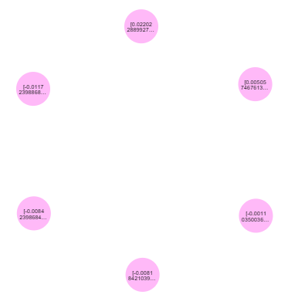
WITH genai.vector.encode(
"What are the risks that Microsoft faces?",
"OpenAI",
{ token: $token }) AS userEmbedding
CALL db.index.vector.queryNodes(
'chunkEmbeddings',
6,
userEmbedding)
YIELD node, score
RETURN node

Slide 63
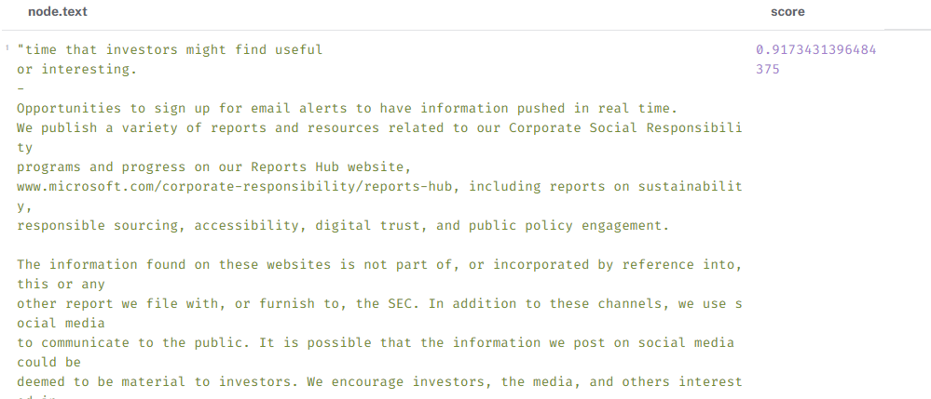

Slide 64
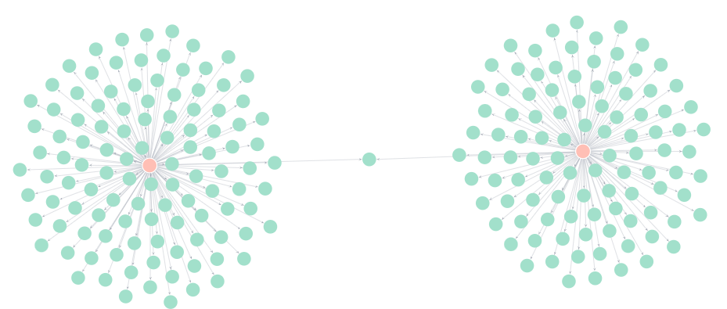
WITH genai.vector.encode(
"What are the risks that Microsoft faces?",
"OpenAI",
{ token: $token }) AS userEmbedding
CALL db.index.vector.queryNodes('chunkEmbeddings', 6, userEmbedding)
YIELD node, score
MATCH (node)-[:FROM_DOCUMENT]->(doc:Document)-[:FILED]
-(company:Company)-[fr:FACES_RISK]->(risk:RiskFactor)
RETURN company, fr, risk

Slide 65
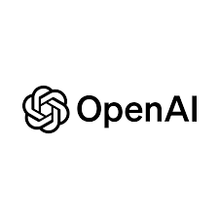


DEMO

Slide 66
Vector
# Create Vector
chunk_vector = Neo4jVector.from_existing_index(
embedding_model,
graph=graph,
index_name="chunkEmbeddings",
embedding_node_property="embedding",
text_node_property="text"
)
# Define a tool to retrieve financial documents
@tool("Retrieve-financial-documents")
def retrieve_docs(query: str):
"""Find details about companies in their financial documents."""
# Use the vector to find relevant documents
context = chunk_vector.similarity_search(
query,
k=3,
)
return context
# Add the tools to the agent
tools = [retrieve_docs]
agent = create_react_agent(
model,
tools
)

Slide 67
Microsoft faces a variety of risks that could impact its operations and financial results. These risks are categorized into strategic and competitive risks, operational risks, legal, regulatory, and litigation risks:
1. **Strategic and Competitive Risks**:
- Intense competition across all markets, including technology and platform-based ecosystems.
- Competitors range in size and capabilities, creating barriers and rapid changes in technology.
- Challenges in maintaining scale and profitability in marketplace ecosystems against competitors who control both hardware and software elements.
2. **Operational Risks**:
- Risks related to product design, manufacturing defects, and reliability issues affecting customer trust and potential legal liabilities.
- Supply chain dependencies, including limited suppliers for certain components and potential disruptions that may affect sales and margins.
- Security vulnerabilities in third-party components, leading to potential costs, liability claims, and reputational damage.
- Challenges in protecting personal data from breaches, misuse, or regulatory liabilities. Increased data breaches heighten the risk environment despite security controls.
3. **Legal, Regulatory, and Litigation Risks**:
- Scrutiny from government agencies and regulatory actions related to competition laws, which are actively enforced, particularly in the EU, U.S., and China.
- Potential regulatory restrictions could limit the design and marketing of products or result in fines.
- Risks related to data and privacy, where improper disclosure could harm reputation and lead to legal exposure.
- Challenges in protecting information and content from unauthorized use, which may weaken product value.
These risks highlight several pressures across different dimensions of Microsoft’s operations, from competitive challenges and technological innovations to regulatory scrutiny and data security issues.

Slide 68
Vector
# Define the retrieval query
retrieval_query = """
MATCH (node)-[:FROM_DOCUMENT]-(doc:Document)-[:FILED]-(company:Company)
RETURN
node.text as text,
score,
{
company: company.name,
risks: [ (company:Company)-[:FACES_RISK]->(risk:RiskFactor) | risk.name ]
} AS metadata
ORDER BY score DESC
"""
# Create Vector
chunk_vector = Neo4jVector.from_existing_index(
embedding_model,
graph=graph,
index_name="chunkEmbeddings",
embedding_node_property="embedding",
text_node_property="text",
retrieval_query=retrieval_query,
)
# Define a tool to retrieve financial documents
@tool("Retrieve-financial-documents")
def retrieve_docs(query: str):
"""Find details about companies in their financial documents."""
# Use the vector to find relevant documents
context = chunk_vector.similarity_search(
query,
k=3,
)
return context
# Add the tools to the agent
tools = [retrieve_docs]
agent = create_react_agent(
model,
tools
)

Slide 69
Microsoft faces a variety of risks that can potentially impact its operations and financial health. Key risks include:
1. **Competition Risks**: Intense competition across all markets, especially in the technology sector. Competitors include both global diversified companies and small specialized firms. Competition among platform-based ecosystems and business models also poses a strategic risk.
2. **Technological Risks**: Risks related to the cost of converting ideas into software products, investment in AI development, and open source competition. There are also execution risks in cloud-based services and enhanced risks in specific industries.
3. **Security and Cybersecurity Risks**: Threats include cyberattacks, security vulnerabilities in products and services, and data breaches. Specific concerns are nation-state attacks, supply chain cyberattacks, and emerging cybersecurity regulations.
4. **Legal and Regulatory Risks**: Includes compliance issues, such as non-compliance with data privacy laws (like GDPR), legal challenges to data transfer frameworks, anti-corruption law violations, and increased costs or fines from trade laws.
5. **Geopolitical and Economic Risks**: These include geopolitical instability, regional epidemics or global pandemics, climate change, and adverse economic or market conditions.
6. **Operational Risks**: Risks associated with supply chain disruptions, quality or supply problems with hardware products, and design defects leading to product liability.
7. **Financial Risks**: Currency risks, interest rate risks, market price risks, and credit exposures. There are unresolved IRS audit issues related to transfer pricing and income taxes in various jurisdictions.
8. **AI and Innovation Risks**: Risks from AI scenarios include reputational or competitive harm, ineffective AI development or deployment practices, ethical issues, and broad societal impacts.
9. **Brand and Reputational Risks**: Reputational harm from GDPR violations, infringement claims, or data privacy and security concerns.
These risks are detailed in Microsoft's financial documents and reflect the comprehensive challenges the company faces in today's dynamic and complex environment.

Slide 70
GraphRAG
1.
Knowledge graph construction
2.
Leveraging connections
Extracting entities and relationships from unstructured text
Using relationships to provide context and answer questions

Slide 71

NODES 2025 - Neo4j Online Developer Conference
NODES is back for its seventh year! Developers and data pros, get ready to learn the latest graph best practices.
When: Thursday, November 6, 2025 Format: Live and unique sessions from community and Neo4j experts
24 hours of technical talks across all time zones
Speakers: Check out the Featured Speakers. Full Agenda coming up Sept 3
Themes: AI Engineering: GenAI, RAG and Agents
App Dev : Libraries, Frameworks, and Platforms Data Intelligence: ML, Algorithms, and Models Knowledge Graphs: Data Integration, Management, and
Visualization.
Learn More: neo4j.com/nodes
Notes:
Speaker notes:
Last year over over 12k registered
+170 unique speakers delivering 145 sessions
Talks are 30 minutes long and lightning talks 15 minutes long
The talks are 20% from Neo4j and 80% from the community (customers, graphistas, users of open source tools)
Agenda will be up on September 1st

Slide 72

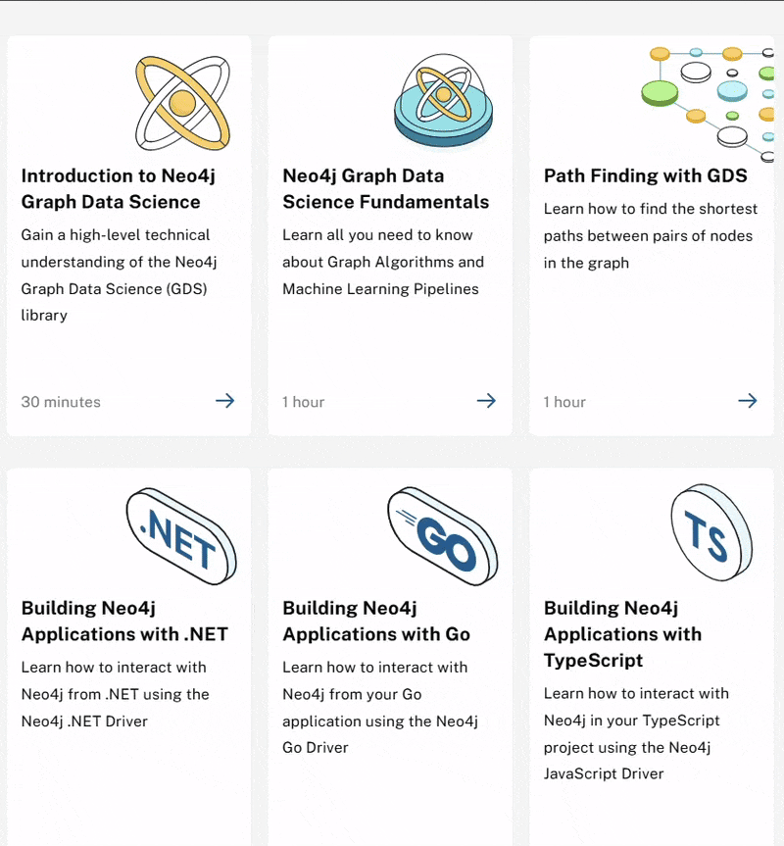
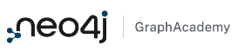
Learn more with
graphacademy.neo4j.com
Completely Free
Hands-on Courses teaching Neo4j Fundamentals, Cypher, Drivers and Graph Data Science
Curated Learning Paths catering for everyone from beginners to experts
Free Certifications
graphacademy.neo4j.com

